Slide 1
Applications
of NLP

Slide 2
Applications
What uses of the computer involve language?
What language use is involved?
What are the main problems?
How successful are they?
<number>/26

Slide 3
Speech applications
Speech recognition (Speech-to-text)
  Uses
    As a general interface to any text-based application
    Text dictation
Speech understanding
  Not the same: computer must understand intention, not necessarily exact words
  Uses
    As a general interface to any application where meaning is important rather than text
    As part of speech translation
Difficulties
  Separating speech from background noise
  Filtering of performance errors (disfluencies)
  Recognizing individual sound distinctions (similar phonemes)
  Variability in human speech
  Ambiguity in language (homophones)
<number>/26

Slide 4
Speech applications
Voice recognition
  Not really a linguistic issue
  But shares some of the techniques and problems
Text-to-speech (Speech synthesis)
  Uses:
    Computer can speak to you
    Useful where user cannot look at (or see) screen
  Difficulties
    Homograph disambiguation
    Prosody determination (pitch, loudness, rhythm)
    Naturalness (pauses, disfluencies?)
<number>/26

Slide 5
Word processing
Check and correct spelling, grammar and style
Types of spelling errors
  Non-existent words
    Easy to identify
    But suggested correction not always appropriate
  Accidental homographs
Deliberate ‘errors’
  Foreign words
  Proper names, neologisms
  Illustrations of spelling errors!
<number>/26

Slide 6
Better word processing
Spell checking for homonyms
Grammar checking
Tuned to the user
  You can (already) add your own auto-corrections
  Non-native users (‘Interference checking’)
  Dyslexics and other special needs users
Intelligent word processing
  Find/replace that knows about morphology, syntax
<number>/26

Slide 7
Text prediction
Speed up word processing
Facilitate text dictation
At lexical level, already seen in SMS
More sophisticated , might be based on corpus of previously seen texts
Especially useful in repeated tasks
  Translation memory
  Authoring memory
<number>/26

Slide 8
Dialogue systems
Computer enters a dialogue with user
  Usually specific cooperative task-oriented dialogue
  Often over the phone
  Examples?
Usually speech-driven, but text also appropriate
Modern application is automatic transaction processing
Limited domain may simplify language aspect
Domain ‘model’ will play a big part
Simplest case: choose closest match from (hidden) menu of expected answers
More realistic versions involve significant problems
<number>/26

Slide 9
Dialogue systems
Apart from speech recognition and synthesis issues, NL components include …
Topic tracking
Anaphora resolution
  Use of pronouns, ellipsis
Reply generation
  Cooperative responses
  Appropriate use of anaphora
<number>/26

Slide 10
(also know as)
Conversation machines
Another old AI goal (cf. Turing test)
Also (amazingly) for amusement
Mainly speech, but also text based
Early famous approaches include ELIZA, which showed what you could do by cheating
Modern versions have a lot of NLP, especially discourse modelling, and focus on the language generation component
<number>/26

Slide 11
QA systems
NL interface to knowledge database
Handling queries in a natural way
Must understand the domain
Even if typed, dialogue must be natural
Handling of anaphora
  e.g. When is the next flight to Sydney?
  And the one after?
  What about Melbourne then?
  6.50
  7.50
  7.20
  OK I’ll take the last one.
<number>/26

Slide 12
IR systems
Like QA systems, but the aim is to retrieve information from textual sources that contain the info, rather than from a structured data base
Two aspects
  Understanding the query
  Processing text to find the answer
Named Entity Recognition
<number>/26

Slide 13
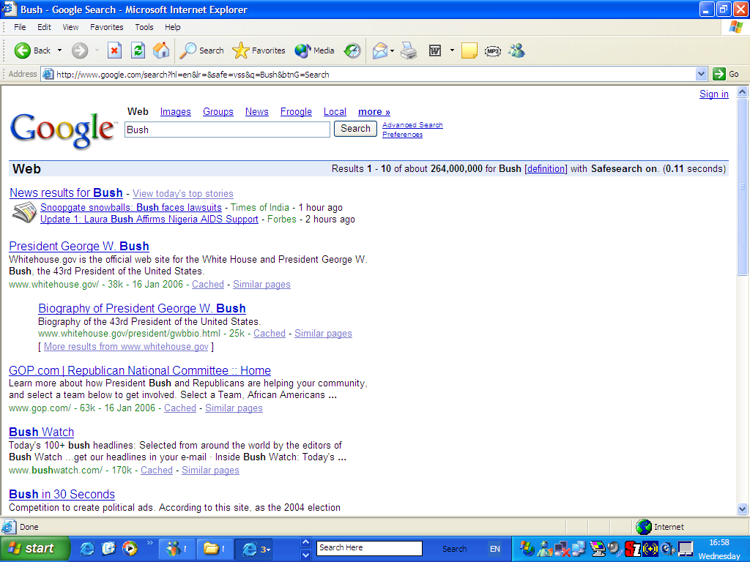
<number>/26

Slide 14
Named entity recognition
Typical textual sources involve names (people, places, corporations), dates, amounts, etc.
NER seeks to identify these strings and label them
Clues are often linguistic
Also involves recognizing synonyms, and processing anaphora
<number>/26

Slide 15
Automatic summarization
Renewed interest since mid 1990s, probably due to growth of WWW
Different types of summary
  indicative vs. informative
  abstract vs. extract
  generic vs. query-oriented
  background vs. just-the-news
  single-document vs. multi-document
<number>/26

Slide 16
Automatic summarization
  topic identification
    stereotypical text structure
    cue words
    high-frequency indicator phrases
    intratext connectivity
    discourse structure centrality
  topic fusion
    concept generalization
    semantic association
  summary generation
    sentence planning to achieve information compaction
<number>/26

Slide 17
Text mining
Discovery by computer of new, previously unknown information, by automatically extracting information from different written resources (typically Internet).
Similar to data mining (e.g. using consumer purchasing patterns to predict which products to place close together on shelves), but based on textual information.
Big application area is biosciences.
<number>/26

Slide 18
Text mining
preprocessing of document collections (text categorization, term extraction)
storage of the intermediate representations
techniques to analyze these intermediate representations (distribution analysis, clustering, trend analysis, association rules, etc.)
visualization of the results.
<number>/26

Slide 19
Story understanding
An old AI application
Involves …
  Inference
  Ability to paraphrase (to demonstrate understanding)
Requires access to real-world knowledge
Often coded in “scripts” and “frames”
<number>/26

Slide 20
Machine Translation
Oldest non-numerical application of computers
Involves processing of source-language as in other applications, plus …
  Choice of target-language words and structures
  Generation of appropriate target-language strings
Main difficulty is source-language analysis and/or cross-lingual transfer implies varying levels of “understanding”, depending on similarities between the two languages
MT ≠ tools for translators, but some overlap
<number>/26

Slide 21
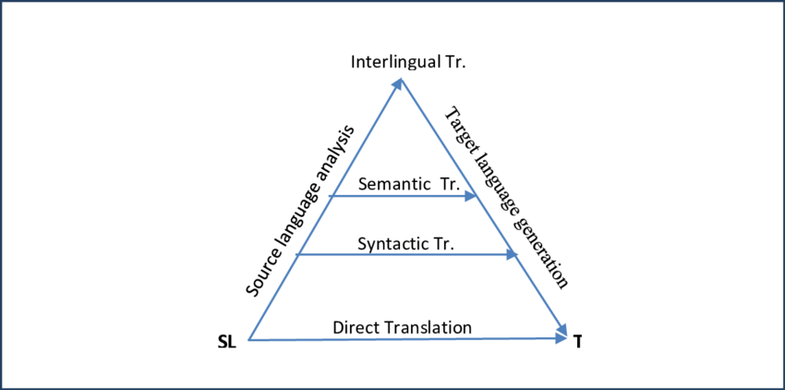
<number>/26

Slide 22
Machine Translation
First approaches perhaps most intuitive: look up words and then do local rearrangement
“Second generation” took linguistic approach: grammars, rule systems, elements of AI
Recent (since 1990) trend to use empirical (statistical) approach based on large corpora of parallel text
  Use existing translations to “learn” translation models, either a priori (Statistical MT ≈ machine learning) or on the fly (Example-based MT ≈ case-based reasoning)
  Convergence of empirical and rationalist (rule-based) approaches: learn models based on treebanks or similar.
<number>/26

Slide 23
Language teaching
CALL
Grammar checking but linked to models of
  The topic
  The learner
  The teaching strategy
Grammars (etc) can be used to create language-learning exercises and drills
<number>/26

Slide 24
Assistive computing
Interfaces for disabled
Many devices involve language issues, e.g.
  Text simplification or summarization for users with low literacy (partially sighted, dyslexic, non-native speaker, illiterate, etc.)
  Text completion (predictive or retrospective)
    Works on basis of probabilities or previous examples
<number>/26

Slide 25
Conclusion
Many different applications
But also many common elements
  Basic tools (lexicons, grammars)
  Ambiguity resolution
  Need (but impossibility of having) for real-world knowledge
Humans are really very good at language
  Can understand noisy or incomplete messages
  Good at guessing and inferring
<number>/26

Slide 26

What is SA & OM?
Identify the orientation of opinion in a piece of text
Can be generalized to a wider set of emotions
The movie
was fabulous!
The movie
stars Mr. X
The movie
was horrible!

Slide 27
Motivation
Knowing sentiment is a very natural ability of a human being.
Can a machine be trained to do it?
SA aims at getting sentiment-related knowledge especially from the huge amount of information on the internet
Can be generally used to understand opinion in a set of documents

Slide 28
Tripod of Sentiment Analysis
Cognitive Science
Sentiment Analysis
Machine Learning
Machine Learning
Natural Language Processing
Natural Language Processing

Slide 29
Why sentiment analysis?
Movie: is this review positive or negative?
Products: what do people think about the new iPhone?
Public sentiment: how is consumer confidence? Is despair increasing?
Politics: what do people think about this candidate or issue?
Prediction: predict election outcomes or market trends from sentiment

Slide 30
Emotion: brief organically synchronized … evaluation of a major event
  angry, sad, joyful, fearful, ashamed, proud, elated
Mood: diffuse non-caused low-intensity long-duration change in subjective feeling
  cheerful, gloomy, irritable, listless, depressed, buoyant
Interpersonal stances: affective stance toward another person in a specific interaction
  friendly, flirtatious, distant, cold, warm, supportive, contemptuous
Attitudes: enduring, affectively colored beliefs, dispositions towards objects or persons
  liking, loving, hating, valuing, desiring
Personality traits: stable personality dispositions and typical behavior tendencies
  nervous, anxious, reckless, morose, hostile, jealous

Slide 31
Sentiment Analysis
Sentiment analysis is the detection of attitudes
  “enduring, affectively colored beliefs, dispositions towards objects or persons”
  Holder (source) of attitude
  Target (aspect) of attitude
  Type of attitude
    From a set of types
      Like, love, hate, value, desire, etc.
    Or (more commonly) simple weighted polarity:
      positive, negative, neutral, together with strength
  Text containing the attitude
    Sentence or entire document

Slide 32
Sentiment Analysis
Simplest task:
  Is the attitude of this text positive or negative?
More complex:
  Rank the attitude of this text from 1 to 5
Advanced:
  Detect the target, source, or complex attitude types

Slide 33
Finding sentiment of a sentence
Important for finding aspects or attributes
  Target of sentiment
The food was great but the service was awful

Slide 34
Finding aspect/attribute/target of sentiment
Frequent phrases + rules
  Find all highly frequent phrases across reviews (“fish tacos”)
  Filter by rules like “occurs right after sentiment word”
    “…great fish tacos” means fish tacos a likely aspect
Casino | casino, buffet, pool, resort, beds
Children’s Barber | haircut, job, experience, kids
Greek Restaurant | food, wine, service, appetizer, lamb
Department Store | selection, department, sales, shop, clothing

Slide 35
Finding aspect/attribute/target of sentiment
The aspect name may not be in the sentence
For restaurants/hotels, aspects are well-understood
Supervised classification
  Hand-label a small corpus of restaurant review sentences with aspect
    food, décor, service, value, NONE
  Train a classifier to assign an aspect to a sentence
    “Given this sentence, is the aspect food, décor, service, value, or NONE”

Slide 36
Putting it all together:
Finding sentiment for aspects
Sentences
& Phrases
Sentences
& Phrases
Sentences
& Phrases
Final
Summary
Reviews
Text
Extractor
Sentiment
Classifier
Aspect
Extractor
Aggregator

Slide 37
Summary on Sentiment
Generally modeled as classification or regression task
  predict a binary or ordinal label
Features:
  Negation is important
  Using all words (in naïve bayes) works well for some tasks
  Finding subsets of words may help in other tasks
    Hand-built polarity lexicons
    Use seeds and semi-supervised learning to induce lexicons

Slide 38
Computational work on other affective states
Emotion:
  Detecting annoyed callers to dialogue system
  Detecting confused/frustrated versus confident students
Mood:
  Finding traumatized or depressed writers
Interpersonal stances:
  Detection of flirtation or friendliness in conversations
Personality traits:
  Detection of extroverts

Slide 39
Detection of Friendliness
Friendly speakers use collaborative conversational style
  Laughter
  Less use of negative emotional words
  More sympathy
    That’s too bad I’m sorry to hear that
  More agreement
    I think so too
  Less hedges
    kind of sort of a little …

Slide 40
Named Entity(NE) Recognition
What is NE and What is not an NE
How to identify NE
Tagset and Annotation Guidelines
Methods Used in developing NER

Slide 41
Why do NER?
Key part of Information Extraction system
Robust handling of proper names essential for many applications such as Summarization, IR, Anaphora,.........
Pre-processing for different classification levels
Information filtering
Information linking

Slide 42
What is NER ?
NER involves identification of proper names in texts, and classification into a set of predefined categories of interest.
Three universally accepted categories:
  Person, location and organisation
Other common tasks: recognition of date/time expressions, measures (percent, money, weight etc), email addresses etc.
Other domain-specific entities: names of Drugs, Genes, medical conditions, names of ships, bibliographic references etc.

Slide 43
NER Definition
Named entity recognition (NER) (also known as entity identification (EI) and entity extraction) is the task that locate and classify atomic elements in text into predefined categories such as the names of persons, organizations, locations, expressions of times, quantities, monetary values, percentages, etc.
John sold 5 companies in 2002.
<ENAMEX TYPE="PERSON">John</ENAMEX> sold <NUMEX TYPE="QUANTITY">5</NUMEX> companies in <TIMEX TYPE="DATE">2002</TIMEX>.

Slide 44
What is not NER?
NER is not event recognition.
NER does not create templates,
NER does not perform co-reference or entity linking,
  though these processes are often implemented alongside NER as part of a larger IE system.
NER is not just matching text strings with pre-defined lists of names.
It recognises entities which are being used as entities in a given context.
NER is not an easy task!

Slide 45
What is Named Entity
Named Entities are
  A Noun Phrase
  Rigid Designators : It designates/denotes the same thing in all possible worlds in which the same thing exists and does not designate anything else in those possible worlds in which that same thing does not exist

Slide 46
EXAMPLES for Named Entity
Hotel & Taj Hotel
Flower & Rose Flower
Beach & Kovalam Beach
Airport & Indira Gandhi International airport
The School & Good Shepherd School

Slide 47
Word Sense Disambiguation (WSD)
Given
  A word in context
  A fixed inventory of potential word senses
  Decide which sense of the word this is
Why? Machine translation, QA, speech synthesis
What set of senses?
  English-­‐to-­‐Spanish MT: set of Spanish translations
  Speech Synthesis: homographs like bass and bow
  In general: the senses in a thesaurus like WordNet

Slide 48
Two variants of WSD task
Lexical Sample task
  Small pre-­‐selected set of target words (line, plant)
  And inventory of senses for each word
  Supervised machine learning: train a classifier for each word
All-­‐words task
  Every word in an entire text
  A lexicon with senses for each word
  Data sparseness: can’t train word-­‐specific classifiers

Slide 49
WSD Methods
Supervised Machine Learning
Thesaurus/Dictionary Methods
Semi-­‐Supervised Learning

Slide 50
Supervised Machine Learning Approaches
Supervised machine learning approach:
  a training corpus of words tagged in context with their sense
  used to train a classifier that can tag words in new text
Summary of what we need:
  the tag set (“sense inventory”)
  the training corpus
  A set of features extracted from the training corpus
  A classifier

Slide 51
Supervised WSD 1: WSD Tags
What’s a tag?
A dictionary sense?
For example, for WordNet an instance of “bass” in a text has 8 possible tags or labels (bass1 through bass8).

Slide 52
8 senses of “bass” in WordNet
bass -­‐ (the lowest part of the musical range)
bass, bass part -­‐ (the lowest part in polyphonic music)
bass, basso -­‐ (an adult male singer with the lowest voice)
sea bass, bass -­‐ (flesh of lean-­‐fleshed saltwater fish of the family Serranidae)
freshwater bass, bass -­‐ (any of various North American lean-­‐fleshed freshwater fishes especially of the genus Micropterus)
bass, bass voice, basso -­‐ (the lowest adult male singing voice)
bass -­‐ (the member with the lowest range of a family of musical instruments)
bass -­‐ (nontechnical name for any of numerous edible marine and freshwater spiny-­‐finned fishes)

Slide 53
Inventory of sense tags for bass
WordNet Sense | Spanish Translation | Roget Category | Target Word in Context
bass⁴ | lubina | FISH/INSECT | . . . fish as Pacific salmon and striped bass and. . .
bass⁴ | lubina | FISH/INSECT | . . . produce filets of smoked bass or sturgeon. . .
bass⁷ | bajo | MUSIC | . . . exciting jazz bass player since Ray Brown. . .
bass⁷ | bajo | MUSIC | . . . play bass because he doesn’t have to solo. . .

Slide 54
Supervised WSD 2: Get a corpus
Lexical sample task:
  Line-­‐hard-­‐serve corpus -­‐ 4000 examples of each
  Interest corpus -­‐ 2369 sense-­‐tagged examples
All words:
  Semantic concordance: a corpus in which each open-­‐class word is labeled with a sense from a specific dictionary/thesaurus.
    SemCor: 234,000 words from Brown Corpus, manually tagged with WordNet senses
    SENSEVAL-­‐3 competition corpora -­‐ 2081 tagged word tokens

Slide 55
Supervised WSD 3: Extract feature vectors
“If one examines the words in a book, one at a time as through an opaque mask with a hole in it one word wide, then it is obviously impossible to determine, one at a time, the meaning of the words…
But if one lengthens the slit in the opaque mask, until one can see not only the central word in question but also say N words on either side, then if N is large enough one can unambiguously decide the meaning of the central word…
The practical question is : ``What minimum value of N will, at least in a tolerable fraction of cases, lead to the correct choice of meaning for the central word?”

Slide 56
Feature vectors
A simple representation for each observation
(each instance of a target word)
  Vectors of sets of feature/value pairs
  Represented as a ordered list of values
  These vectors represent, e.g., the window of words around the target

Slide 57
Two kinds of features in the vectors
Collocational features and bag-­‐of-­‐words features
  Collocational
    Features about words at specific positions near target word
      Often limited to just word identity and POS
  Bag-­‐of-­‐words
    Features about words that occur anywhere in the window (regardless of position)
      Typically limited to frequency counts

Slide 58
Examples
Example text (WSJ):
An electric guitar and bass player stand off to one side not really part of the scene
Assume a window of +/-­‐ 2 from the target

Slide 59
Examples
Example text (WSJ)
An electric guitar and bass player stand off to one side not really part of the scene,
Assume a window of +/-­‐ 2 from the target

Slide 60
Collocational features
Position-­‐specific information about the words and collocations in window
•
guitar
and bass
player
stand
, POS_{i—2}, w_{i—1}, POS_{i—1}, w_{i+1}, POS_{i+1}, w_{i+2}, POS , w
i—1 i+1
[wi—2
i+2
, w ]
i—2 i
[guitar, NN, and, CC, player, NN, stand, VB, and guitar, player stand]
word 1,2,3 grams in window of ±3 is common

Slide 61
Bag-­‐of-­‐words features
“an unordered set of words” – position ignored
Counts of words occur within the window.
First choose a vocabulary
Then count how often each of those terms occurs in a given window
  sometimes just a binary “indicator” 1 or 0

Slide 62
Co-­‐Occurrence Example
Assume we’ve settled on a possible vocabulary of 12 words in “bass” sentences:
[fishing, big, sound, player, fly, rod, pound, double, runs, playing, guitar, band]
The vector for:
guitar and bass player stand
[0,0,0,1,0,0,0,0,0,0,1,0]

Slide 63
Classification: definition
Input:
  a word w and some features f
  a fixed set of classes C = {c₁, c₂,…, c_{J}}
Output: a predicted class c∈C

Slide 64
Classification Methods: Supervised Machine Learning
Input:
  a word w in a text window d (which we’ll call a “document”)
  a fixed set of classes C = {c₁, c₂,…, c_{J}}
  A training set of m hand-­‐labeled text windows again called “documents” (d₁,c₁),....,(d_{m},c_{m})
Output:
  a learned classifier γ:d →→ c
22

Slide 65
Classification Methods: Supervised Machine Learning
Any kind of classifier
  Naive Bayes
  Logistic regression
  Neural Networks
  Support-­‐vector machines
  k-­‐Nearest Neighbors
  …

Slide 66
Applying Naive Bayes to WSD
P(c) is the prior probability of that sense
  Counting in a labeled training set.
P(w|c) conditional probability of a word given a particular sense
  P(w|c) = count(w,c)/count(c)
We get both of these from a tagged corpus like SemCor
Can also generalize to look at other features besides words.
  Then it would be P(f|c)
    Conditional probability of a feature given a sense

Slide 67
The Simplified Lesk algorithm
Let’s disambiguate “bank” in this sentence:
The bank can guarantee deposits will eventually cover future tuition costs because it invests in adjustable-­‐rate mortgage securities.
given the following two WordNet senses:
bank¹ | Gloss: Examples: | a financial institution that accepts deposits and channels the money into lending activities “he cashed a check at the bank”, “that bank holds the mortgage on my home”
bank² | Gloss: Examples: | sloping land (especially the slope beside a body of water) “they pulled the canoe up on the bank”, “he sat on the bank of the river and watched the currents”

Slide 68
The Simplified Lesk algorithm
Choose sense with most word overlap between gloss and context
(not counting function words)
The bank can guarantee deposits will eventually cover future tuition costs because it invests in adjustable-­‐rate mortgage securities.
bank¹ | Gloss: Examples: | a financial institution that accepts deposits and channels the money into lending activities “he cashed a check at the bank”, “that bank holds the mortgage on my home”
bank² | Gloss: Examples: | sloping land (especially the slope beside a body of water) “they pulled the canoe up on the bank”, “he sat on the bank of the river and watched the currents”

Slide 69
The Corpus Lesk algorithm
Assumes we have some sense-­‐labeled data (like SemCor)
Take all the sentences with the relevant word sense:
These short, "streamlined" meetings usually are sponsored by local banks¹, Chambers of Commerce, trade associations, or other civic organizations.
Now add these to the gloss + examples for each sense, call it the “signature” of a sense.
Choose sense with most word overlap between context and signature.

Slide 70
Corpus Lesk: IDF weighting
Instead of just removing function words
  Weigh each word by its `promiscuity’ across documents
  Down-­‐weights words that occur in every `document’ (gloss, example, etc)
  These are generally function words, but is a more fine-­‐grained measure
Weigh each overlapping word by inverse document frequency
34

Slide 71
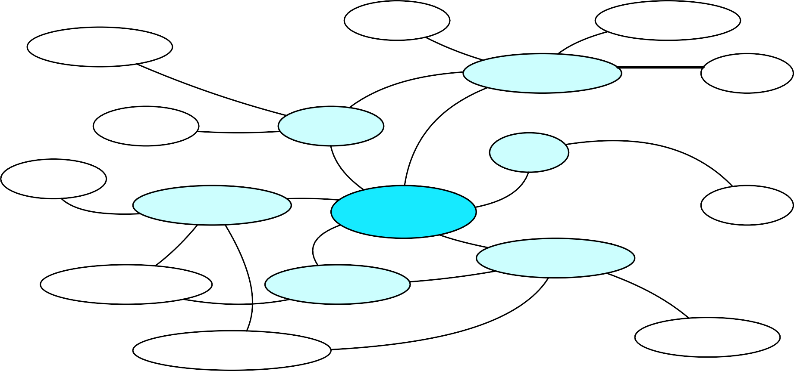
Graph-­‐based methods
First, WordNet can be viewed as a graph
  senses are nodes
  relations (hypernymy, meronymy) are edges
  Also add edge between word and unambiguous gloss words
food_{n}¹
liquid_{n}¹
helping_{n}¹
beverage_{n}¹
milk ¹
n
toast_{n}⁴
drink_{n}¹
sip_{v}¹
sup_{v}¹
consume ¹
drink_{v}
1
sip ¹
v
n
drinking_{n}¹
consumer_{n}¹ drinker_{n}¹
consumption_{n}¹
36
potation_{n}¹

Slide 72
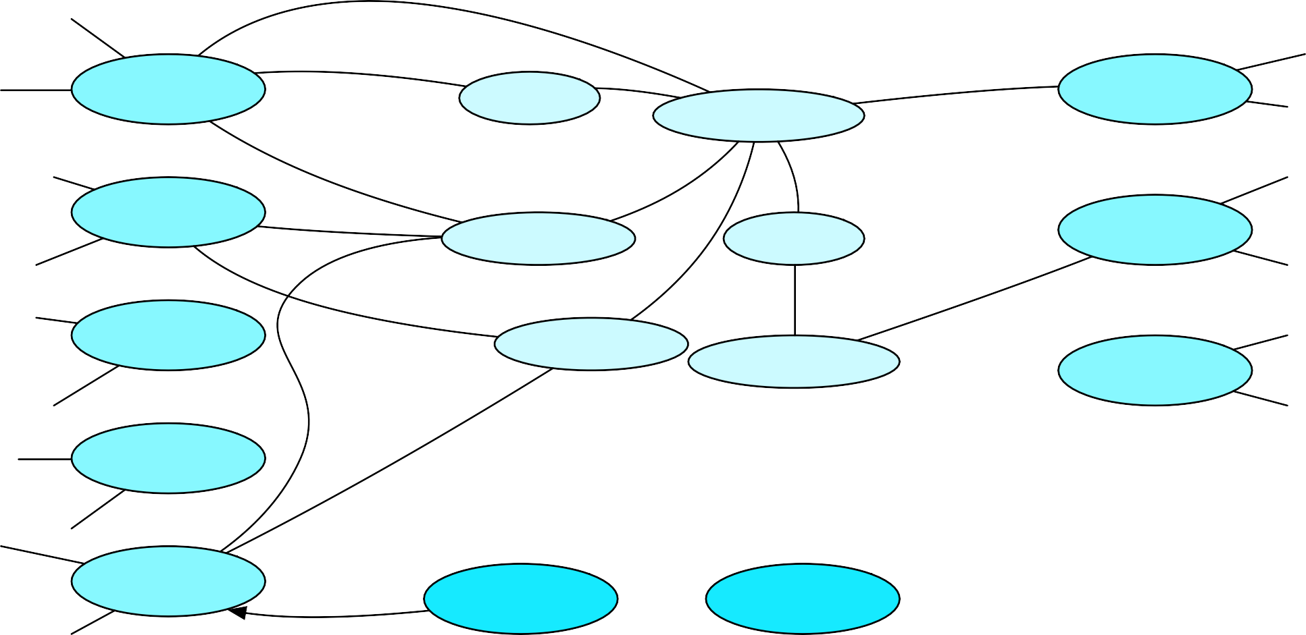
How to use the graph for WSD
Insert target word and words in its sentential context into the graph, with directed edges to their senses
“She drank some milk”
Now choose the
most central sense Add some probability to “drink” and “milk” and compute node with
1
drink_{v}
drink_{n}¹
1
milk_{n}
beverage_{n}¹
2
drink_{v}
2
milk_{n}
drinker_{n}¹
food_{n}¹
drink ³
boozing ¹
v
n
nutriment_{n}¹
3
milk_{n}
4
drink_{v}
milk ⁴
highest “pagerank”
n
37
drink ⁵
v
“drink”
“milk”

Slide 73
Semi-­‐Supervised Learning
Problem: supervised and dictionary-­‐based approaches require large hand-­‐built resources
What if you don’t have so much training data?
Solution: Bootstrapping
Generalize from a very small hand-­‐labeled seed-­‐set.

Slide 74
Bootstrapping
For bass
  Rely on “One sense per collocation” rule
    A word reoccurring in collocation with the same word will almost surely have the same sense.
  the word play occurs with the music sense of bass
  the word fish occurs with the fish sense of bass

Slide 75
Sentences extracting using “fish” and
“play”
We need more good teachers – right now, there are only a half a dozen who can play
the free bass with ease.
An electric guitar and bass player stand off to one side, not really part of the scene, just as a sort of nod to gringo expectations perhaps.
The researchers said the worms spend part of their life cycle in such fish as Pacific
salmon and striped bass and Pacific rockfish or snapper.
And it all started when fishermen decided the striped bass in Lake Mead were too skinny.

Slide 76
Summary: generating seeds
Hand labeling
“One sense per collocation”:
  A word reoccurring in collocation with the same word will almost surely have the same sense.
“One sense per discourse”:
  The sense of a word is highly consistent within a document -­‐ Yarowsky (1995)
  (At least for non-­‐function words, and especially topic-­‐specific words)

Slide 77


Stages in the Yarowsky bootstrapping algorithm for the word “plant”
?
?
LIFE
?
?
?
?
?
?
? ?
?
? A
LIFE
?
?
?
?
? ?
?
?
?
A
?
?
?
?
? ? ?
? ?
? ?
?
? ?
?
?
?
A
?
?
?
_{A} A
? ? ?
? ? ?
?
?
?
?
?
? ?
? ?
?
?
A
A
? ?
? ?
?
?
?
? ?
? ?
?
?
?? ?
? ? ?
A A
A
?
?
A
A A
A _{A}
? ?
?
?
?
A
A A
A _{A}
? ?
?
?
?
? ? ?
A
V
A _{A A}
A
?
? ? ? ?
V
A
? A
?
A A
?
?
A
? A
A
A A
MICROSCOPIC
?
A A
A A
?
?
?
??
?
0
?
A A
A A
?
?
?
??
? ?
1
?
?
A
A
?
?
?
_{A} A
A
? ?
?
_{A} A
??
?
?
?
?
? ? ?
? ?
?
?
A
A
?
?
?
?
?
? ?
?
?
?
?
?
?
A
A
A
?
?
? ?
? ?
? ?
?
? ?
?
??
? ?
?
? ?
?
?
?
?
? ?
?
? ?
?
?
ANIMAL
?
?
?
?
?
? ?
?
? ? ? ?
?
? ?
? ?
?
? ?
?
?
?
?
? ?
? ?
?
? ? ? ?
?
? ?
? ?
?
?
?
?
? ?
? Λ
?
? ?
?
?
?
?
Λ₁ ? ?
EMPLOYEE ?
?
?
0
??
?
?
B ?
B B
B
?
?
?
? ?
?
?
B ?
B B
B
??
? B
B
?
?
?
?
?
?
? ?
?
?
?
?
?
?
?
?
?
?
?
?
?
?
?
?
?
?
?
B
?
?
?
?
? B
B B B
_{B} B
?
?
? B
B B B
_{B} B
?
?
?
?
? ?
?
?
?
?
B
B
B
?
?
?
B _{B}
?
?
?
B
B
B _{B}
? ?? ?
? ?
? ?
?
?? ? ? ?
?
?
?
EQUIPMENT
?
?
? ? ? ?
? ? ?
? ?
MANUFACTURING
? ?
MANUFACTURING
? ?
(a)
(b)

Slide 78
Summary
Word Sense Disambiguation: choosing correct sense in context
Applications: MT, QA, etc.
Three classes of Methods
  Supervised Machine Learning: Naive Bayes classifier
  Thesaurus/Dictionary Methods
  Semi-­‐Supervised Learning
Main intuition
  There is lots of information in a word’s context
  Simple algorithms based just on word counts can be surprisingly good
44

Slide 79
Text Classiﬁcation
Assigning subject categories, topics, or genres
Spam detection
Authorship identiﬁcation
Age/gender identiﬁcation
Language Identiﬁcation
Sentiment analysis
…

Slide 80
Text Classiﬁcation: deﬁnition
Dan Jurafsky
Input:
  a document d
  a ﬁxed set of classes C = {c₁, c₂,…, c_{J}}
Output: a predicted class c ∈ C

Slide 81
Classiﬁcation Methods: Hand-­‐coded rules
Rules based on combinations of words or other features
  spam: black-­‐list-­‐address OR (“dollars” AND“have been selected”)
Accuracy can be high
  If rules carefully reﬁned by expert
But building and maintaining these rules is expensive

Slide 82
Classiﬁcation Methods: Supervised Machine Learning
Dan Jurafsky
Input:
  a document d
  a ﬁxed set of classes C = {c₁, c₂,…, c_{J}}
  A training set of m hand-­‐labeled documents (d₁,c₁),....,(d_{m},c_{m})
Output:
  a learned classiﬁer γ:d  c
10

Slide 83
Classiﬁcation Methods: Supervised Machine Learning
Dan Jurafsky
Any kind of classiﬁer
  Naïve Bayes
  Logistic regression
  Support-­‐vector machines
  k-­‐Nearest Neighbors
  …

